Slide 1


Telecommunications
Churn Prediction
PREDICTING CUSTOMER CHURN IN TELECOM :
MISSING VALUES, OUTLIERS IN BILLING AMOUNTS, INCONSISTENCIES IN CATEGORICAL VARIABLES.

Slide 2

What is Customer Churn?
Customer churn is defined as when customers or subscribers discontinue using sevices of firm.
what is Telcom Customer Churn ?
Customers in telecmunication can switch to one Service privider to another this can cause the telcom cutomer churn.

Slide 3


Common Causes of Telecom Churn
Poor Network Quality (dropped calls, slow internet)
High Pricing (competitors offering better deals)
Poor Customer Service (unresolved complaints)
Lack of Personalization (customers feel undervalued)
Billing Issues (hidden charges, incorrect bills)

Slide 4
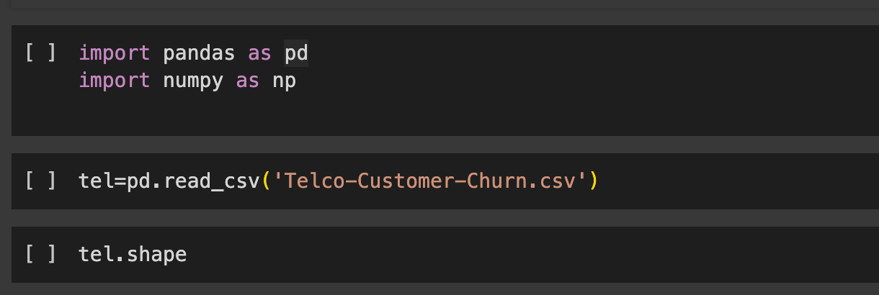

Here Telcom Customer Churn dataset is got from Kaggle
Loading Libraries and Data:
This data set is about 7043 cutomer records out of then 1869 Cutomers

Slide 5
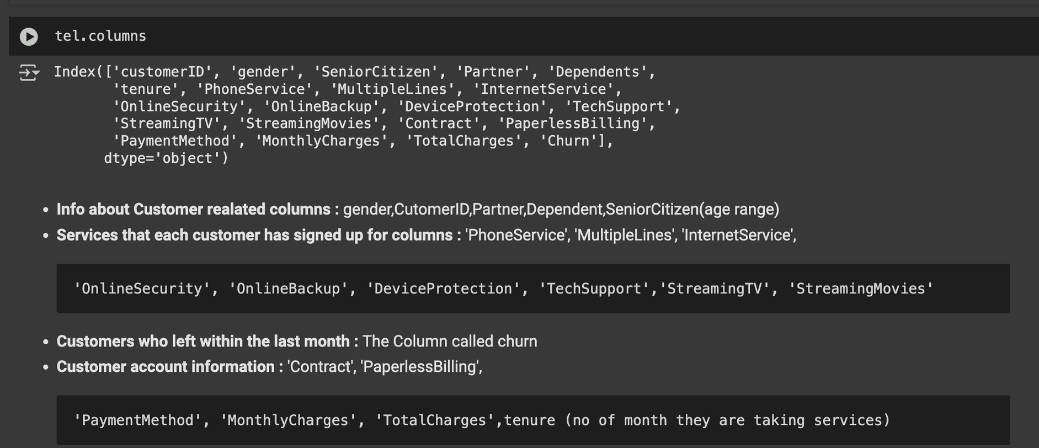
Columns Discription

Slide 6
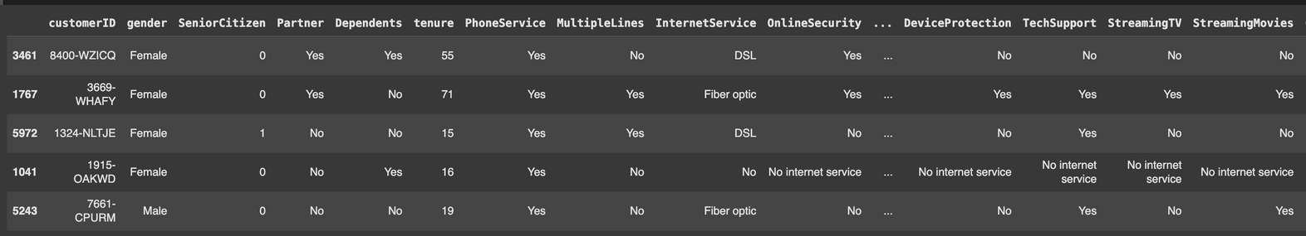
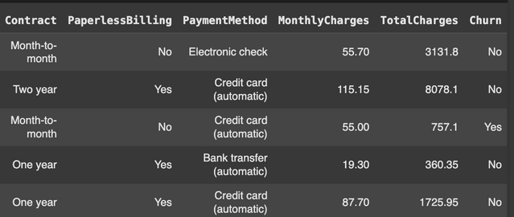
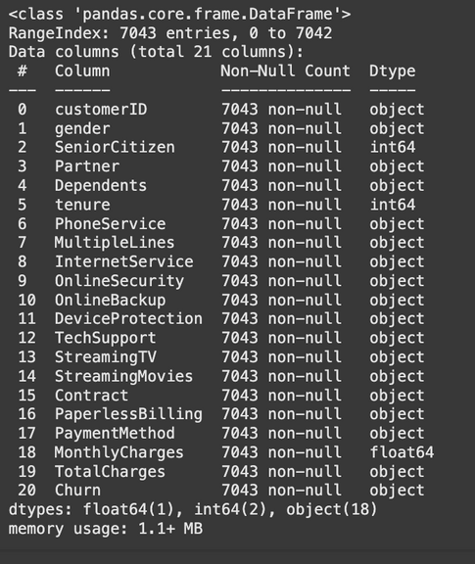
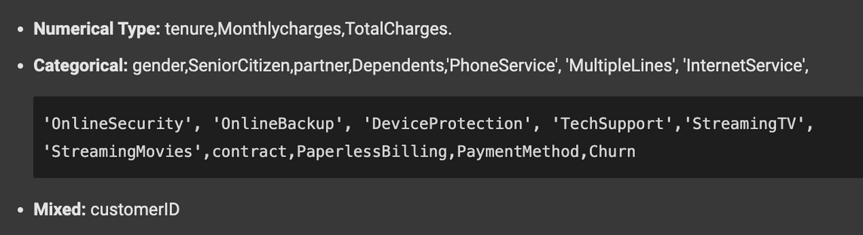
lets see random 5 records of cutomer
tel.sample(5)
tel.info()

Slide 7
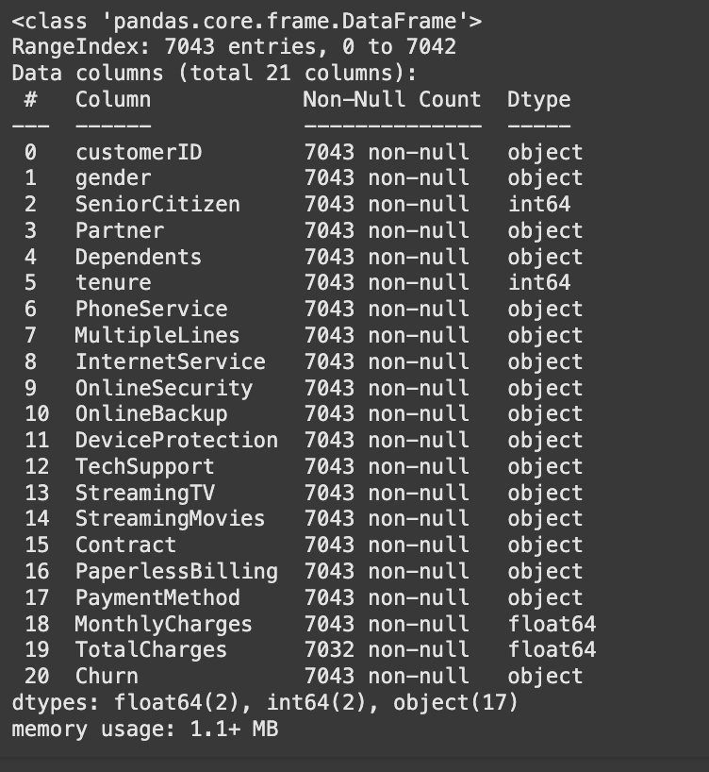
tel['TotalCharges']=pd.to_numeric(tel['TotalCharges'],errors='coerce')
tel.info()

Slide 8
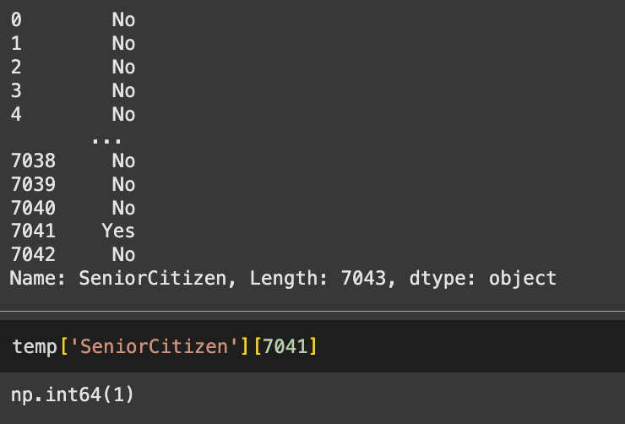
temp=tel.copy()
tel['SeniorCitizen']=list(tel['SeniorCitizen'].map({0:'No',1:'Yes'}))
tel['SeniorCitizen']

Slide 9
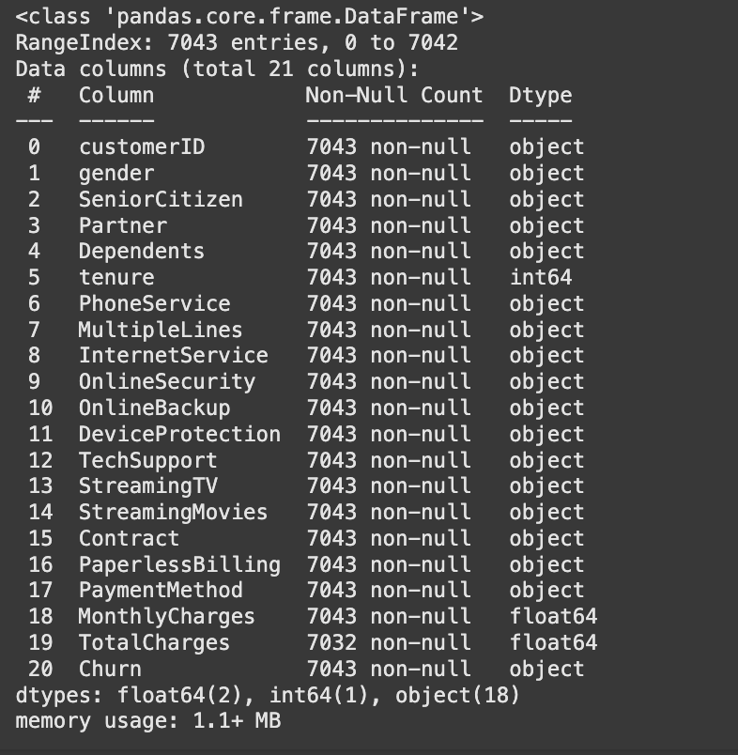
tel.info()

Slide 10
Data Cleaning
tel[tel['TotalCharges'].isnull()]
tel[tel['tenure']==0]
tel[tel['Dependents']=='Yes']
# tel=tel[tel['tenure']!=0]
tel[tel['Contract']=='Two year']['tenure'].describe()
df_temp=tel[(tel['Contract']=='Two year') & (tel['PaymentMethod']=='Mailed check')]
# df_temp.isnull().sum
df_temp.dropna(inplace=True)
df_temp.head(2)
.
.
Cleaning Done

Slide 11
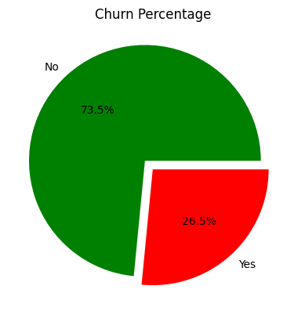
Data Visulization
import seaborn as sns
import matplotlib.pyplot as plt
plt.pie(tel['Churn'].value_counts(),labels=['No','Yes'],autopct='%1.1f%%',colors=['green','red'],explode=[0.1, 0])
plt.title("Churn Percentage")
plt.show()

Slide 12
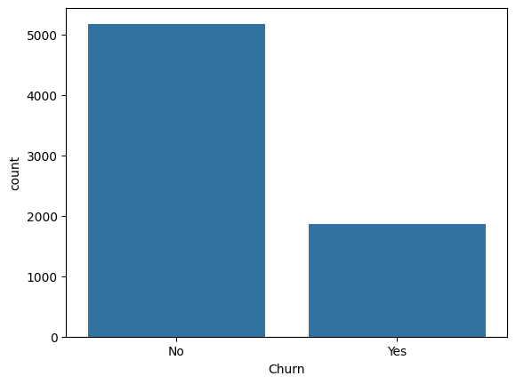
Data Visulization
sns.countplot(data=tel,x='Churn')

Slide 13
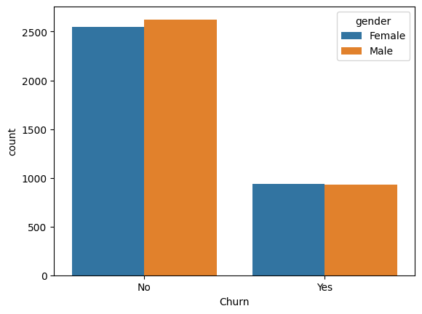
Data Visulization
sns.countplot(data=tel,x='Churn',hue='gender')

Slide 14
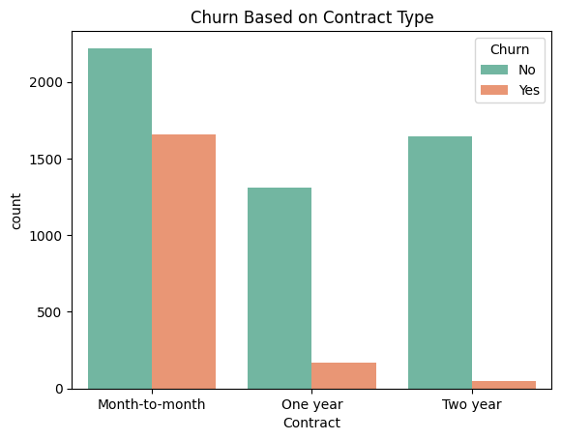
Data Visulization
sns.countplot(data=tel,x='Contract',hue='Churn',palette="Set2")
plt.title('Churn Based on Contract Type')

Slide 15
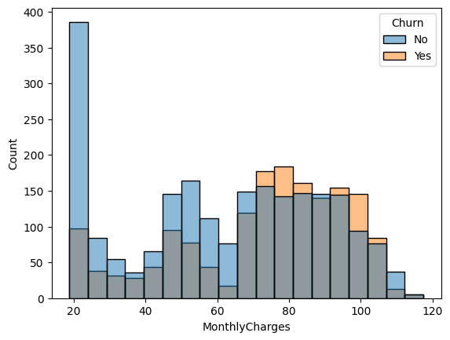
Data Visulization
df=tel[tel['Contract']=='Month-to-month']
# sns.histplot(data=tel,tel['
df.sample()
sns.histplot(data=tel,x=df['MonthlyCharges'],hue='Churn')

Slide 16
Data Visulization
sns.countplot(data=tel,x='Contract',hue='Churn',palette="Set2")
plt.title('Churn Based on Contract Type')

Slide 17
Data Visulization
df=tel[tel['Contract']=='Month-to-month']
# sns.histplot(data=tel,tel['
df.sample()
sns.histplot(data=tel,x=df['MonthlyCharges'],hue='Churn')

Slide 18
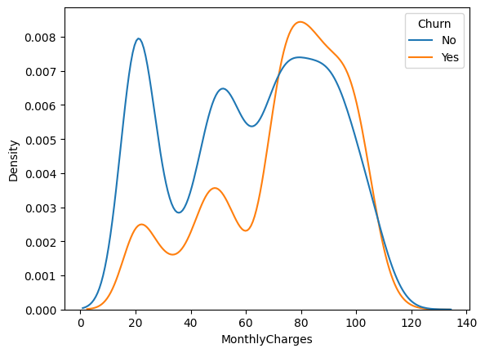
Data Visulization
sns.kdeplot(data=tel,x=df['MonthlyCharges'],hue='Churn')

Slide 19
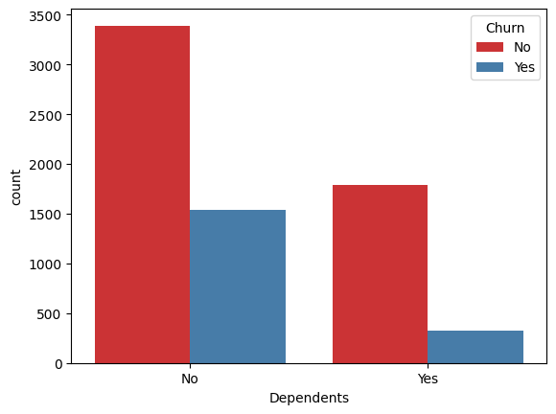
Data Visulization
tel.sample()
sns.countplot(data=tel,x=tel['Dependents'],hue=tel['Churn'],palette='Set1')

Slide 20
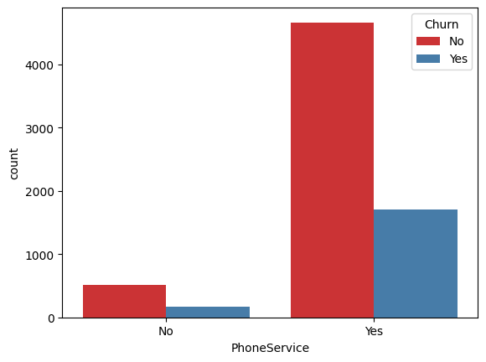
Data Visulization
sns.countplot(data=tel,x=tel['PhoneService'],hue='Churn',palette='Set1')

Slide 21
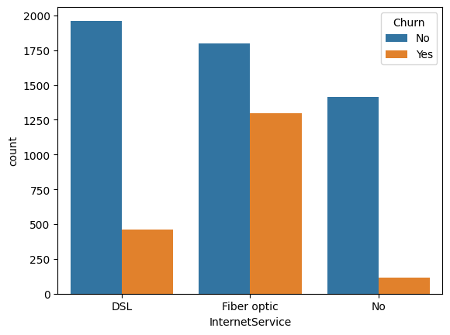
Data Visulization
sns.countplot(data=tel,x=tel['InternetService'],hue='Churn')
sns.countplot(data=tel,x=tel['OnlineSecurity'],hue='Churn')
sns.countplot(data=tel,x=tel['DeviceProtection'],hue=tel['Churn'])
sns.countplot(data=tel,x=tel['PaperlessBilling'],hue=tel['Churn'])

Slide 22
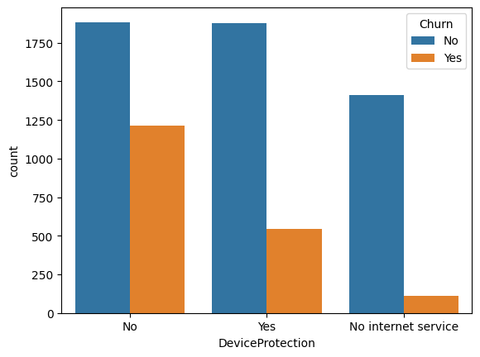
Data Visulization
sns.countplot(data=tel,x=tel['TechSupport'],hue=tel['Churn'])
sns.countplot(data=tel,x=tel['StreamingTV'],hue=tel['Churn'])
sns.countplot(data=tel,x=tel['DeviceProtection'],hue=tel['Churn'])
sns.countplot(data=tel,x=tel['StreamingMovies'],hue=tel['Churn'])

Slide 23
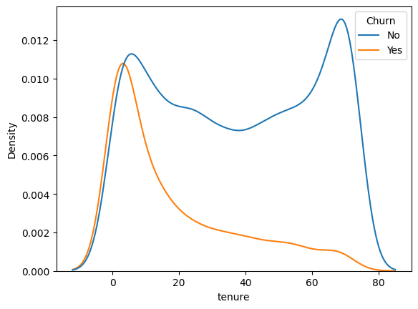
Data Visulization
sns.kdeplot(data=tel,x=tel['tenure'],hue=tel['Churn'])

Slide 24
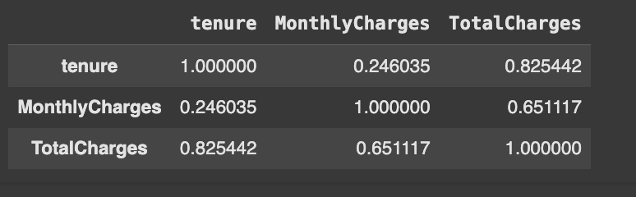
Data Visulization
tdf=tel[['tenure','MonthlyCharges','TotalCharges']]
tcorrelational=tdf.corr()
tcorrelational

Slide 25
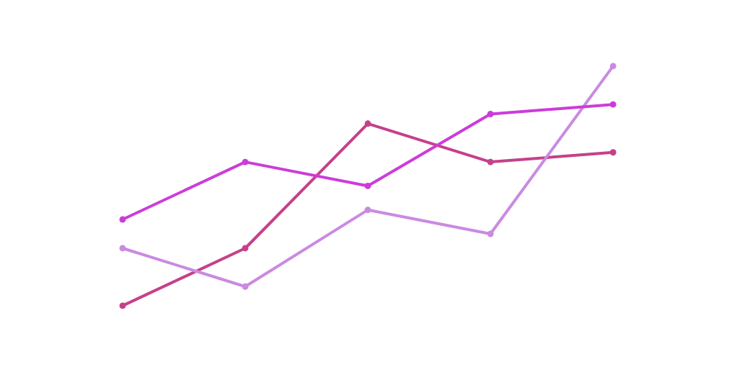

CONCLUSION

Slide 26
thank
you!
PREDICTING CUSTOMER CHURN IN TELECOM

